Slide 1
Online Edu. Employment
-
-
Team VEL
07 Oct. 2015

Slide 2
1. Development Plan
Initialization
Design
Sprint01
Sprint02
Final Presentation

Slide 3
2. Project Achievement
100% of the initial product backlog is implemented over sprint01
100% of the additional product backlog is completed by sprint02

Slide 4
3. User Stories (Sprint 2)
Homepage polish
Test automation page
Contact us integration
Dynamic Team profile
New success stories List
Research on Google searching strategies

Slide 5
4. Homepage Polish
Change layout to present information more efficiently
Add visitor counter for statistics
Add Contact US link
Cut the height of main image on phone view

Slide 6
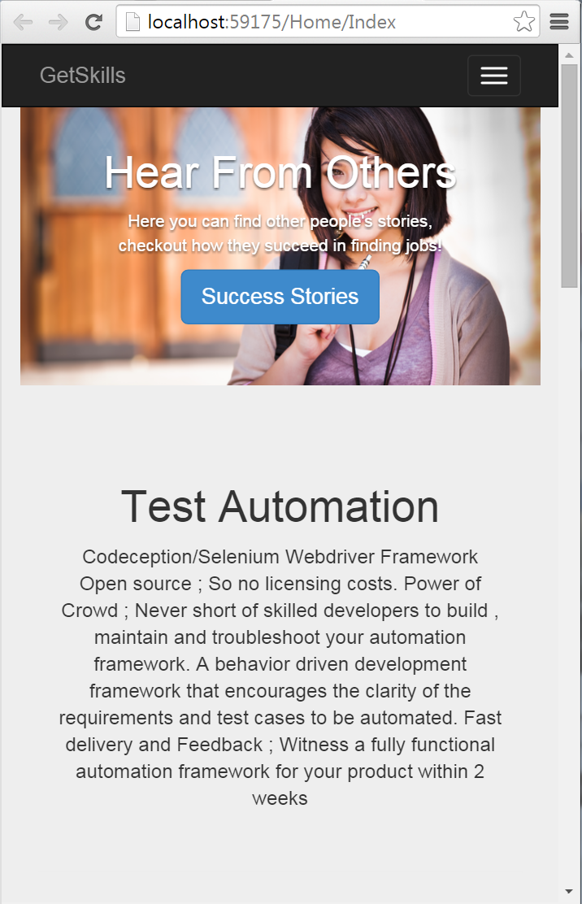
5. Mobile Friendly
Previously the image will take over the whole page
Now we add screen detection control to increase mobile user experience

Slide 7
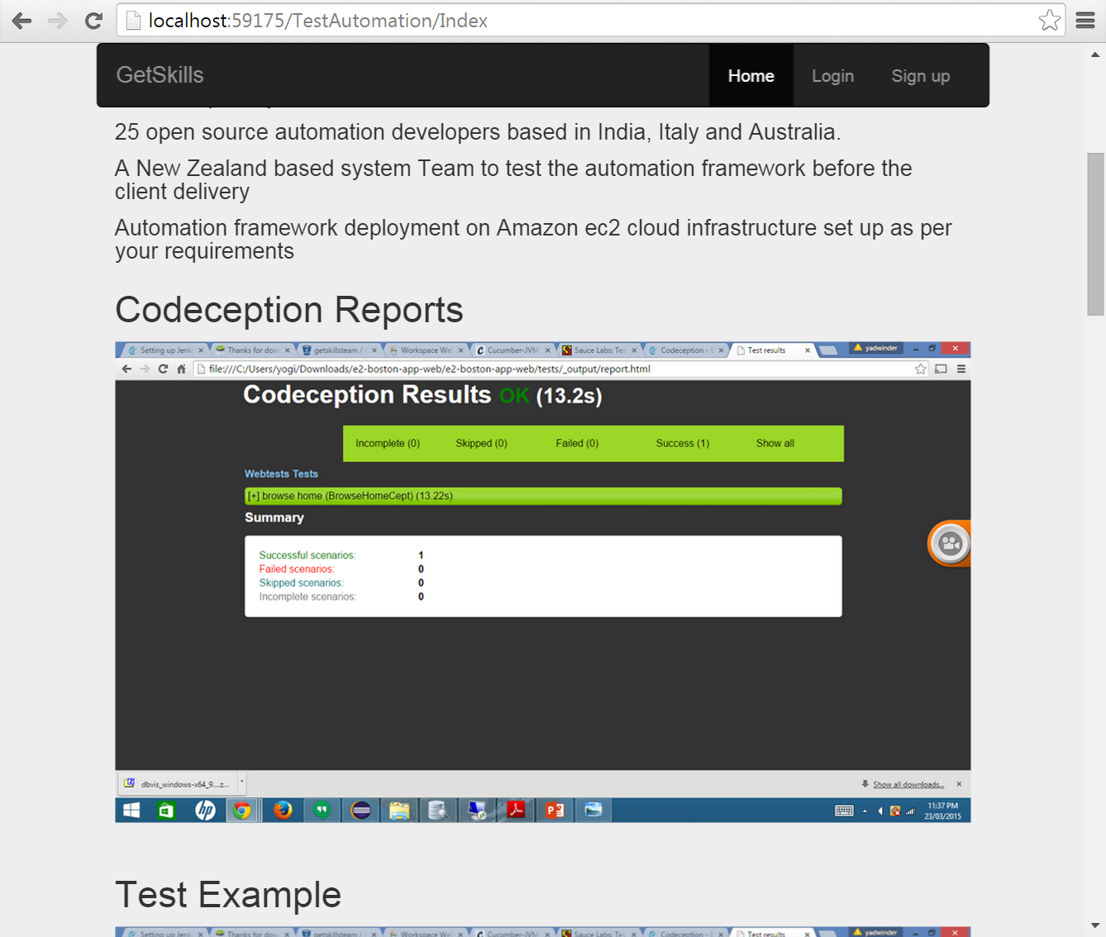
6. Test Automation

Slide 8
7. Team Profile
1) Client View
Client view page
2) Admin Function
List page
Add page
Edit page
Delete page

Slide 9
8. Testing

